Slide 1
Body weight gain in clozapine treated patients: Is norclozapine the culprit?
Naomi Jessurun
PharmD, klinisch farmacoloog
Clozapinewerkgroep
26-11-21

Slide 2
Dissertation / disclosure
The role of drug metabolization and drug metabolites in the developing of adverse drug reactions

Slide 3
Inhoud
Achtergrond
Clozapine en gewichtstoename
Is norclozapine de schuldige?

Slide 4
Background - BMI distribution
BMI classification based on WHO 1997
2001;62 Suppl 7:22-31.

Slide 5
Background – controverse BWG
Untreated patients with schizophrenia and affective disorders have been reported to have higher rates of diabetes and obesity compared with the general population
Waist circumference is larger in schizofrenie patients and relatives, and patients using clozapine and olanzapine
BWG is not predictable, not dose related. The interation between diagnosis, treatment and environment is complex. Multifactorial
Roerig et al. Atypical Antipsychotic induced weight gain. CNS Drugs 2011;25(12): 1035-1059

Slide 6
Background – BWG risk factors

Slide 7
Background: second generation antipsychotica (SGA)
https://medialibrary.uantwerpen.be/oldcontent/container2911/files/2011/centraal%20zenuwstelsel%202.pdf

Slide 8
Background: second generation antipsychotica (SGA) -ADRs
https://medialibrary.uantwerpen.be/oldcontent/container2911/files/2011/centraal%20zenuwstelsel%202.pdf

Slide 9
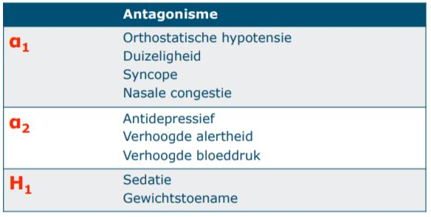
Background: mechanisms of BWG in SGAs
https://medialibrary.uantwerpen.be/oldcontent/container2911/files/2011/centraal%20zenuwstelsel%202.pdf

Slide 10
Background: mechanisms of BWG in SGAs
https://medialibrary.uantwerpen.be/oldcontent/container2911/files/2011/centraal%20zenuwstelsel%202.pdf

Slide 11
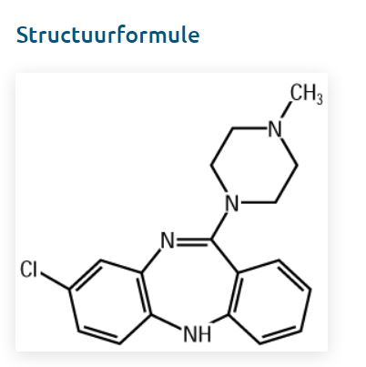
Clozapine
Clozapine kwam in 1969 al op de markt, verwijderd vanwege agranulocytose en in 1989 weer toegelaten met controle bloedbeeld
Bijwerkingen: sedatie, gewichtstoename, convulsies, hypotensie

Slide 12
Clozapine – BWG door norclozapine?
CYP1A2

Slide 13
Clozapine – BWG door norclozapine?
Both norclozapine and clozapine have actions at
Histaminergic, serotonergic, dopaminergic and muscarinic receptors which potentially mediate antipsychotica actions and metabolic side effects.
The two compounds have differential receptor activity voor serotonine receptoren and norclozapine may have greater metabolic consequences

Slide 14
Clozapine – BWG door norclozapine?
Receptor | Norclozapine | Clozapine
5-HT_{2c} | Antagonisme, hoge affiniteit | Antagonisme
D₂ | Partiёle agonist | Inverse agonist/antagonist
D₃ | Partiёle agonist | Inverse agonist/antagonist
M₁ | Potent partiёle agonist | Zwakke agonist
α₁ | Antagonist ↓ 5x | Antagonist
H₁ | Antagonist ↓↓ 50x | Antagonist

Slide 15
J Clin Psychiatry 2004;65:766–771

Slide 16
Clozapine – BWG door norclozapine?
↓
fluvoxamine
CYP1A2↓

Slide 17
Adjunctive fluvoxamine
Addition of fluvoxamine to clozapine treatment is well toleraterd + could improve the psychopathofysiology of schziphrenic patients.
Fluvoxamine inhibits the formation of norclozapine by inhibiting CYP1A2
Lu et al.: coadministration of fluvoxamine could attenuate weight gain and serum levels of glucose, triglycerides and cholesterol in clozapine recipients

Slide 18
Adjunctive fluvoxamine
Study population:
68 treatment-resistant inpatients with a DSM-IV diagnosis of schizophrenia were randomly assigned to 2 treatment groups for 12 weeks.
Monotherapy group (n = 34, F=24 (70%)) : received clozapine 600 mg/day
Fluvoxamine additive group (n = 34, F=24 (70%)) : received fluvoxamine 50 mg/day plus low-dose clozapine 250 mg/day

Slide 19
Adjunctive fluvoxamine

Slide 20
Adjunctive fluvoxamine

Slide 21
Adjunctive fluvoxamine

Slide 22
J Clin Psychopharmacol 2016;36: 120–124

Slide 23
Predicting weight gain in clozapine users
Weight gain on clozapine is highly variable and poorly predictable. Its mechanisms are not well understood.
Aim of the study: to determine predictors of weight gain between 3 to 12 monthts of clozapine therapy in community dwelling patients and to better understand the underlying mechanisms

Slide 24
Predicting weight gain in clozapine users
Study population:
Patients attending an outpatient clozapine clinic
Study design:
Retrospective audit on weight change
Univariate analyse compared % weight change according to seks, smoking status, country of birth, and baseline BMI.
Exploration of weight gain, age, and clozapine
General lineair model identified independent predictors of weight gain
Outcome: % of weight change of the 3-month weight

Slide 25
Predicting weight gain in clozapine users
N=117, female 50 (43%)

Slide 26
Clozapine – BWG door norclozapine?
Smoking is well known to increase the conversion of clozapine to norclozpaine via induction of CYP1A2
Clozapine : norclozapine ratio was significantly higher in non-smokers vs smokers (2.1 vs 1.8, p< 0.01)
↑
Smoking
CYP1A2↑

Slide 27
Predicting weight gain in clozapine users
Conclusion:
Smoking affects weight change by promoting clozapine metabolism to norclozapine via CYP P450 enzymes (CYP1A2, red.).
However clozapine and norclozapine serum levels were not included in the model.

Slide 28
Br J Clin Pharmacol. 2021;1–5

Slide 29
Norclozapine the culprit?

Slide 30
Norclozapine the culprit?
Hypothese:
Higher norclozapine serum levels result in higher BMI and larger waist circumference.
De relatie tussen norclozapinespiegels en buikomvang was niet eerder onderzocht

Slide 31
Norclozapine the culprit?
Primary aim:
To asses the correlation between norclozapine serum levels and BMI and waist circumference
Secondary aim:
To assess the correlation between norclozapine serum levels and other parameters of the metabolic syndrome, such as triglycerides, HDL-cholesterol, fasting blood glucose, HbA1c

Slide 32
Norclozapine the culprit?
Study population:
Patients visiting a specialized clozapine outpatient clinic from the Reinier van Arkel Mental Health Insitute in ‘s-Hertogenbosch.
Study design:
Observational, retrospective cross-sectional study

Slide 33
Norclozapine the culprit?
Inclusion criteria (all patients visiting the clinic were eligible):
> 18 years or older
Valid measurements of norclozapine serum levels
Measurement of BW and WC ± 1 month [norclo]
Data collection (1 Jan 2017 – 1 Jul 2020):
Measurements of triglyceride, HDL-cholesterol, fasting blood glucose and HbA1c ± 3 months [norclo]
Measurements nearest to [norclo] were included
Stratification: smokers / non-smokers

Slide 34
Norclozapine the culprit?
Data analysis:
Pearson correlation coefficients for clozapine, norclozapine and norclozapine/clozapine with BMI, waist circumference and the other parameters and stratified for smokers and non-smokers.
No corrections for multiple tests, as there were underlying hypotheses
Sample size calculations: minimum of 29 patients

Slide 35
Norclozapine the culprit?
Results:
The clozapine outpatient clinic comprised 44 patients.
5 patients did not meet the inclusion criteria (2 patients had no valid [NORCLO], 1 patient had no BW measured, 1 patient had no WC measures, 1 patient refused blood tests)
Study population = 39

Slide 37
Norclozapine the culprit?
Patient caracteristics BMI
Kg/m² | Category | # (%) patients
< 18.5 | Underweight | 0 (0)
18.5 – 24.9 | Normal | 13 (33)
25.0 – 29.9 | Overweight | 18 (46)
30.0 – 39.9 | Obese | 7 (18)
> 40.0 | Morbid obese | 1 (3)

Slide 38
Norclozapine the culprit?
Patient characteristics Waist circumference
 | Criteria | # (%) abdomibal obesity
Female | > 88 cm | 7 (87.5%)
Male | > 102 cm | 17 (54.8%)

Slide 39
Norclozapine the culprit?
Correlations
[NORCLO] ~ BMI: r=0.282, p=0.08
smokers: r=0.627, p=0.005
non-smokers: r=-0.035, p=0.88
[NORCLO] ~ WC: r=0.354, p=0,03
smokers: r=0.723, p=0.001
non-smokers: r= -0.043, p=0.85

Slide 40
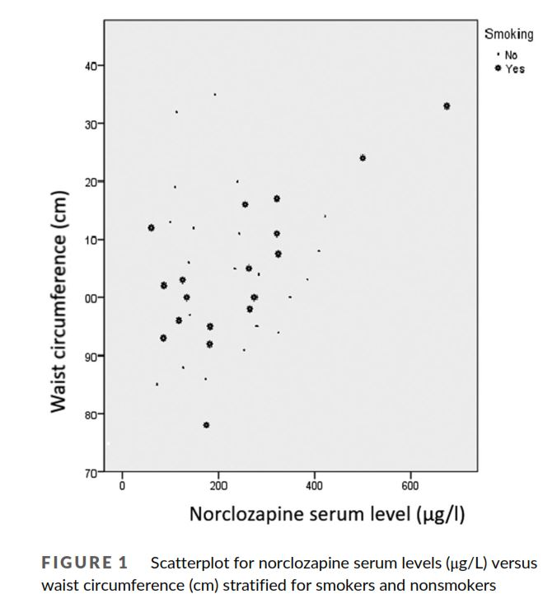

Slide 42
Norclozapine the culprit?

Slide 43
Norclozapine the culprit?
Limitations:
Cross-sectional design
Rather small sample size
Risk factors are not included

Slide 44
Norclozapine the culprit?
Future
The correlation with waits circumference allows for more attention in clinical practice
Interventions to decrease the formation of norclozapine such as smoking cessation and fluvoxamine addition

