Slide 1

Herstel van psychose
zonder/ met zo min mogelijk
antipsychotica

Slide 2


Slide 3
Disclosure
I prescribe antipsychotics
Sometimes even coercively
Antipsychotics support the practice of community health

Slide 4
Contents
Discontinuation trials
Soteria
Rethink long term antipsychotics
Study Wunderink
CBT in patients without antipsychotics
Conclusions and recommendations: start and reduce timely, start slow, stop slow

Slide 5
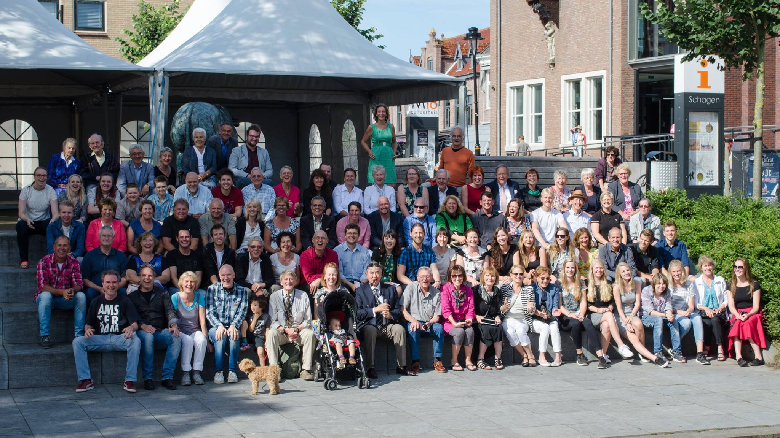

Slide 8
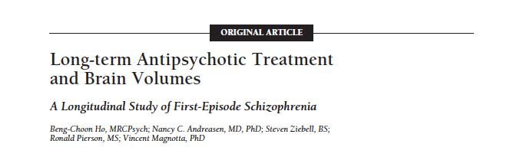
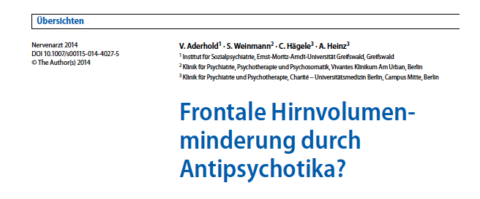
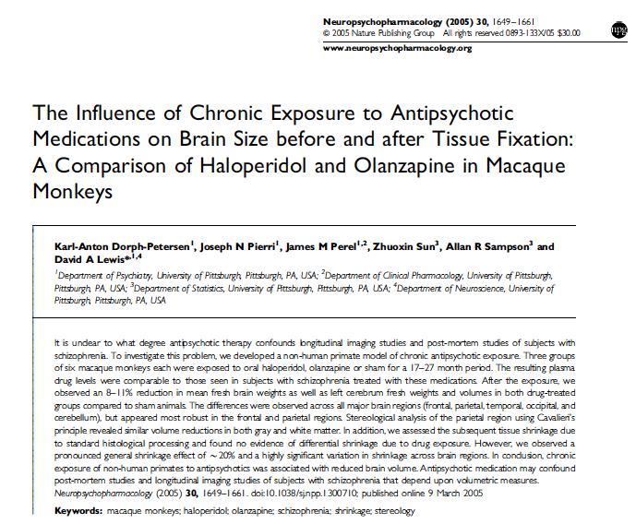
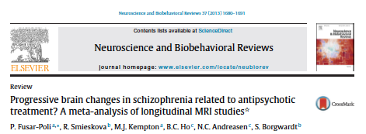
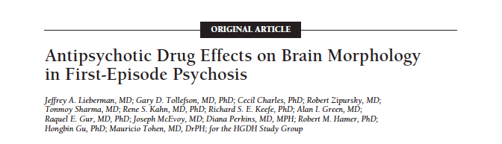

Slide 9
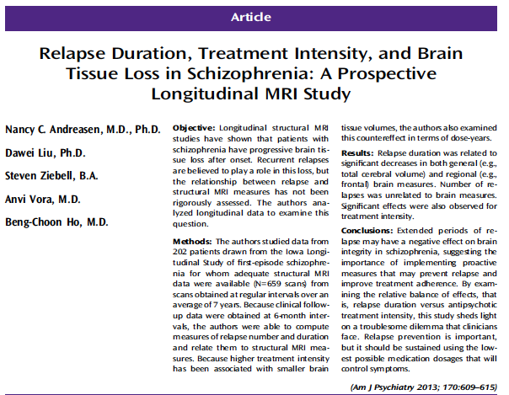
A dilemma

Slide 11
Antipsychotica and relapse
Both predict reduction brain volume
Effects antipsychotics diffusely distributed
  Frontal, temporal, parietal
Effects relapses strongly associated with frontal lobe tissue changes

Slide 12
Conclusion

Slide 13


* Soteria werd opgericht in 1971 in San José,
Californië.
* Soteria betekent redding of verlossing.
* Loren Mosher, psychiater was de initiatiefnemer.
* 12 kamers
* 6 hulpvragers, 2 stafmedewerkers (een man en een vrouw) en diverse vrijwilligers.
* Bewoners en stafleden zorgden gezamenlijk voor het huishouden.
* Men werkte in diensten van 36 tot 48 uur.
* De staf bestond uit niet psychiatrisch geschoolde mensen die wel behandel- verantwoordelijkheid droegen en daarvoor ook de bevoegdheid hadden.
Terug in de tijd
WAT IS SOTERIA?

Slide 14
Soteria Core principles
Small community based setting
Lay person staffing
Preservation of personal power and social network
Being with/ doing with
Give meaning to subjective experience

Slide 15
8 therapeutical principals as practical guidelines for Soteria (Ciompi & Hoffmann, 2004)
1 Small, relaxing, stimulus-protecting and as ‘normal’ as possible therapeutic setting
2 Continuous personalized ‘being with’ the psychotic patient
3 Personal and conceptual continuity
4 Close collaboration with family members and other important persons of reference
5 Clear and concordant information for patients, family and staff
6 Elaboration of common realistic goals and expectations
7 Consensual low dose antipsychotic strategies
8 After care and relapse prevention for at least two years

Slide 16
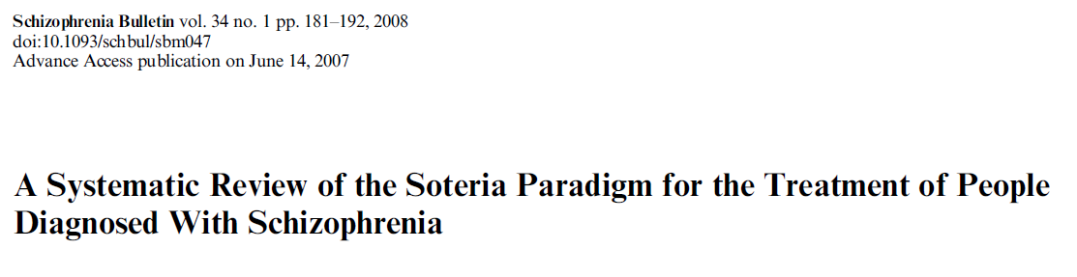

Slide 17
3 CT’s
USA data on 2 cohorts of patients admitted to Soteria between 1971–1976
Switzerland 1976–1979 compared patients admitted to Soteria with control group patients admitted to hospital.

Slide 18
Significant Outcome USA studies
Endpoint analysis:
  Living alone or with peers
Completer analysis
  Global psychopathology
Other outcomes
  Not significant, favor Soteria

Slide 19
Less medication
First 6 weeks: 24 % versus 100%
  16 % > 1 week
After 2 years 57 (USA) /61 % (Bern) versus 97%
Mean daily dose lower in USA and Bern

Slide 20
Soteria Emergis Bridging The Gap Between In- And Outpatient Care For Young People With Psychosis
Jaco Balkenende
Fryda Evertse

Slide 21

Soteria Emergis
At the edge of the terrain
12 hour shifts
Drugs free
Tranquility

Slide 22
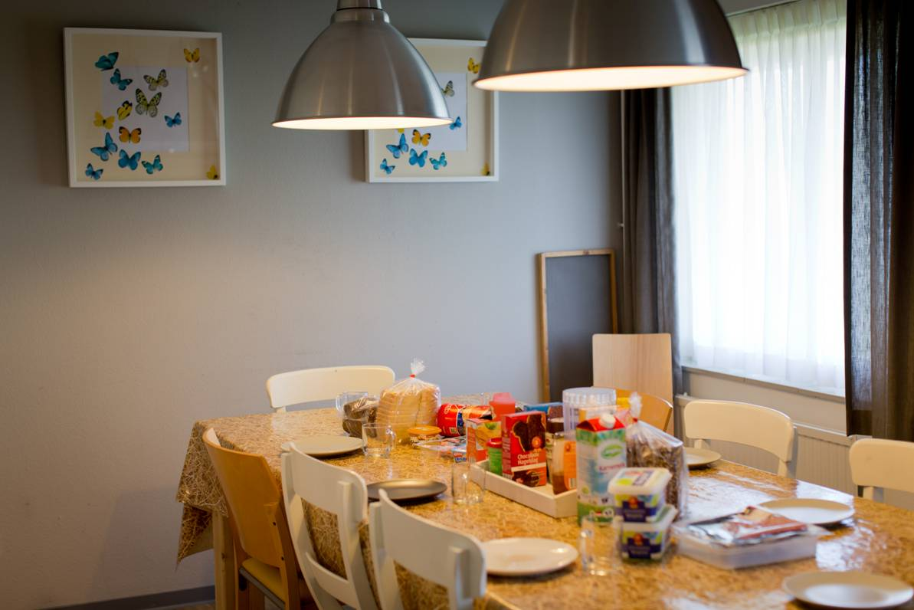
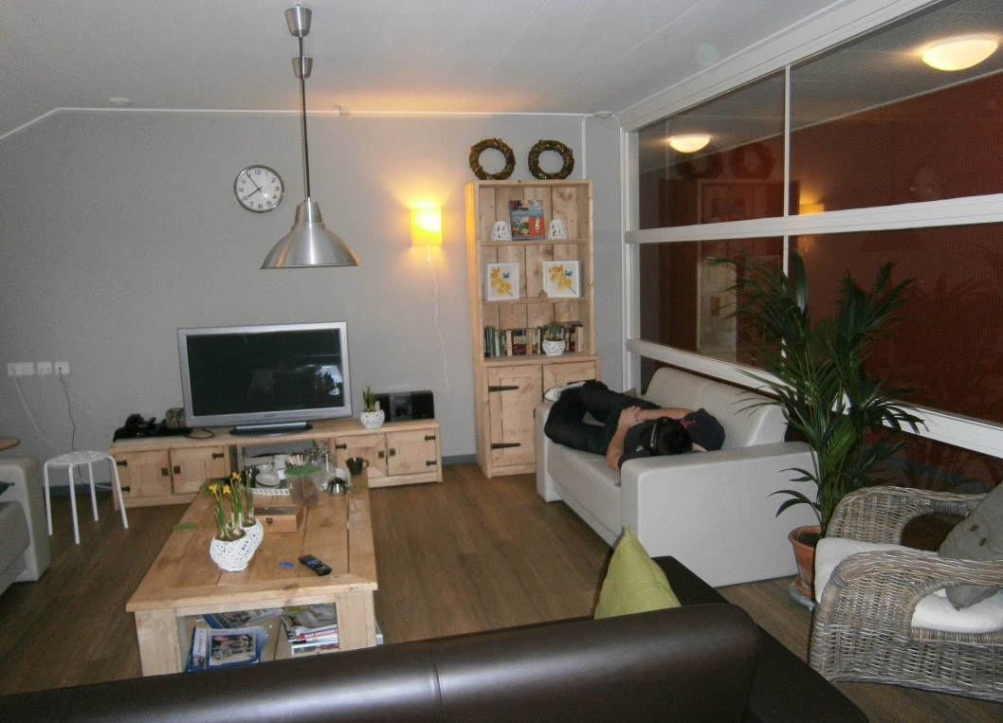
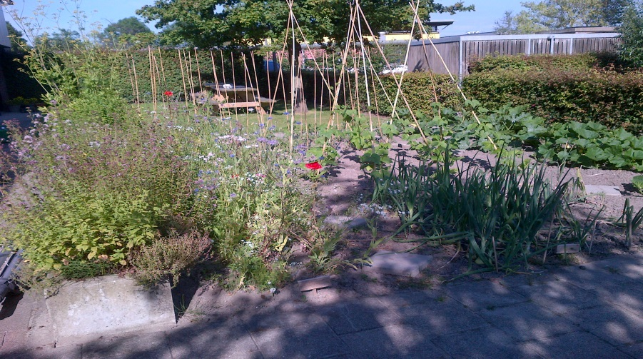

Slide 23
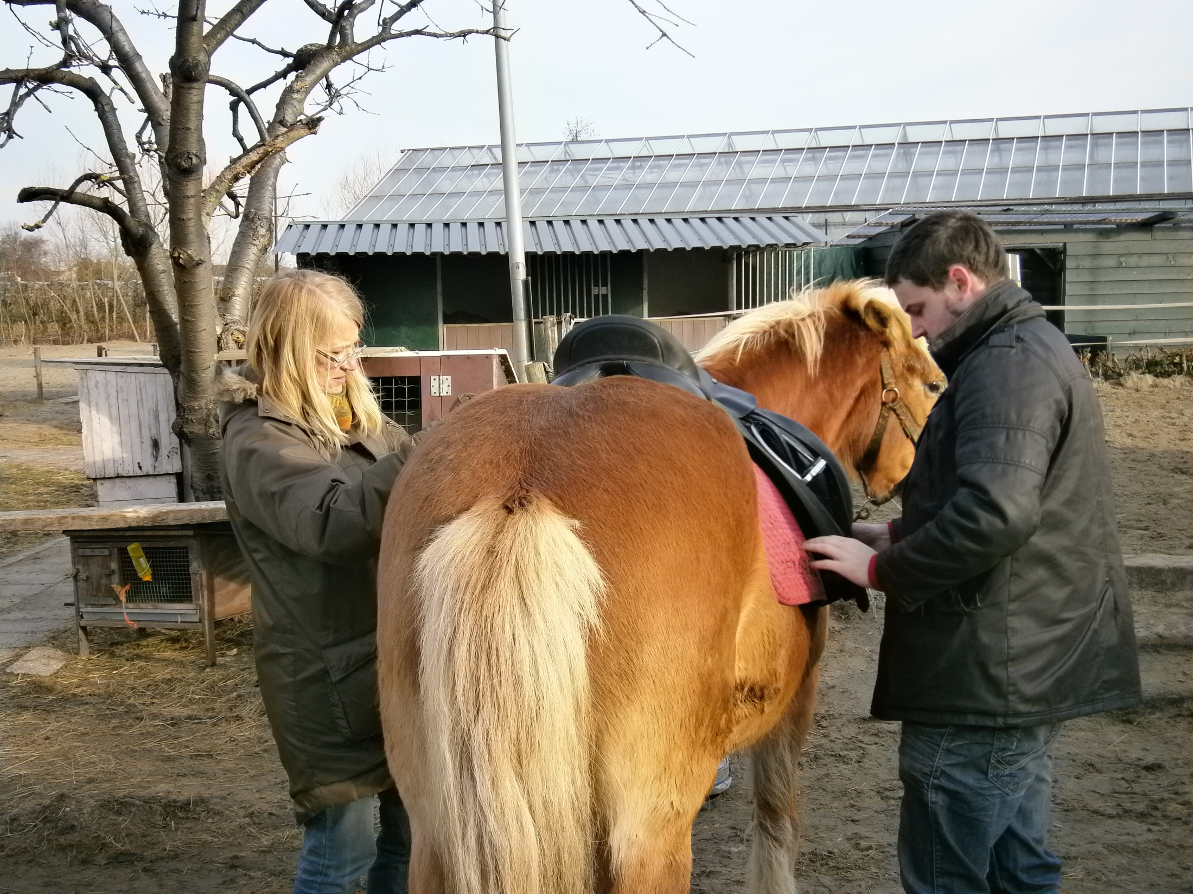

Slide 24
Programma
Equitherapie
Zingeving
Yoga
Sporten
Boerderij
Samen schoonmaken

Slide 25
Medicatie: 9/10 antipsychotica
Risperidon 2-4 mg
Olanzapine 10-15 mg
Clozapine 75 mg
Aripiprazol 10-15 mg
Flupentixol 7 mg
Haloperidol 15 mg/ olanzapine 20 mg

Slide 26
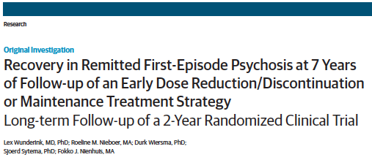

Slide 27
Key question
Is maintenance treatment after remission of a first episode of psychosis the best option?
Originele discontinuatie studie

Slide 28
Practical issues in antipsychotic maintenance therapy
> 50% of patients do not accept long-term antipsychotic treatment and discontinue < 1 year
Present guidelines do not account for differences in course characteristics or symptom profiles
Same treatment recommendations go for remitted and nonremitted patients
Exclusive focus on relapse prevention obscures evaluation of real-life outcome

Slide 29
We did an RCT in remitted FEP comparing dose-reduction and maintenance strategy
In dose-reduction/discontinuation compared to maintenance we hypothesized:
Better Quality of Life and Functioning levels
Probably at the cost of:
Higher relapse rates

Slide 30
Design of the study
Onset
psychosis
Entry &
Selection
Response
Start experimental phase
Discontinuation Challenge
Ta
T0
T6
Maintenance Treatment
T15
T24
1st assessment
2nd assessment
3rd assessment
4th assessment
Informed consent
Randomization
“Unblinding” randomization at T5

Slide 31
Consort flow chart
Oct 2001 through Dec 2002
257 eligible for trial
100 meeting criteria but refusing or lost to follow-up
157 randomised
8 nonremitting 9 relapsing 1 suicide
11 informed consent withdrawn
128 trial group

Slide 32
After 2 years…
Only 21.5% could be taken off drugs
No difference in quality of life between arms
No difference in functioning level, but better vocational functioning, bordering on significance (35% vs. 17%, OR=2.4, P = .06)
Twice as many relapses in dose-reduction/discontinuation strategy vs. maintenance treatment: 42% against 21% in 18 months
No gains, but more relapses, though benign and relatively mild; no impact on inpatient days or symptom severity

Slide 33
7-years follow-up
Long-term effects of dose reduction/discontinuation strategies on recovery have not been studied before
Aim: to compare rates of recovery
103 (80,5%) of 128 patients were located and consented to follow-up assessment

Slide 34
Definitions of recovery, symptomatic and functional remission
Recovery = meeting criteria for symptomatic and functional remission during 6 months
Symptomatic remission: meeting working group criteria (Andreasen et al, 2005)
Functional remission: no or only mild impairment on self-care, housekeeping, family relationships, relationships with peers, community integration, and vocational functioning

Slide 35
Recovery, symptomatic and functional remission after 7 years
 | DR (n=52) | MT (n=51) | Total sample (n=103)
Recovery | 21 (40.4%) | 9 (17.6%) | 30 (29.1)
Symptom remission | 36 (69.2%) | 34 (66.7%) | 70 (68.0)
Functional remission | 24 (46.2%) | 10 (19.6%) | 34 (33.0)

Slide 36
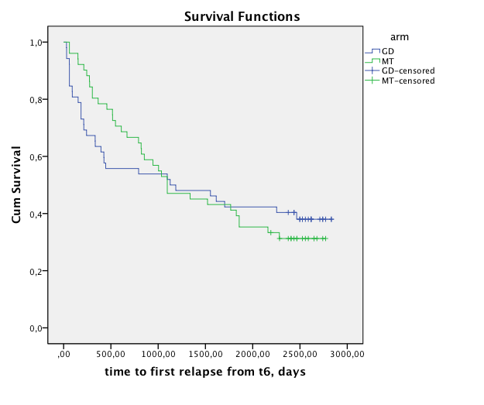
Relapse rates over 7 years of follow-up
Kaplan Meier survival analysis of time to first relapse after first remission during 7 years of follow-up in patients receiving Guided Discontinuation (GD) or Maintenance Treatment (MT) from t6 (start of trial after 6 months of first remission) to t90 (final follow-up)

Slide 38
Conclusions (1)
First study to find major advantages of a dose reduction/discontinuation strategy in remitted FEP
Recovery and functional remission rates in DR twice those of MT patients (40.4% vs. 17.6% and 46.2% vs. 19.6%)
No difference in symptom remission rates (69.2% vs. 66.7%)
No apparent differences in any conceivable confounders

Slide 39
Conclusions (2)
No differences on short term follow-up (2 years) but only at long-term
No differences in relapse rates or symptomatic domains, but only in the domains of functional capacity and recovery
Schizophrenia treatment strategy studies should include recovery as an outcome variable, and include follow-up for more than 2 years, e.g. 5 or even 7 years.

Slide 40
Possible explanations
Lower load of antipsychotic drugs?
  Relief of redundant dopamine blockade, not necessary to treat psychosis
  Better allowing cognitive and functional recovery
Psychological impact of being able to reduce or even stop antipsychotic treatment?
  Fitting in with currrent conception of doctor-patient relationship, self-management, shared decision making

Slide 41
Take home messages
Geef zo snel mogelijk antipsychotica bij positieve symptomen (boven de UHR drempel)
Geef een zo laag mogelijke dosis, vooral bij eerste episode psychosen
Probeer na remissie van positieve symptomen de dosering verder te verminderen op geleide van de symptomatologie, in nauw overleg met de goed geïnformeerde patiënt en de familie
Bij eerste episoden meer kans van slagen
Als het kan, antipsychotica geheel staken; wel monitoren
Bij opnieuw optreden van symptomen dosering ophogen of herstarten

Slide 42
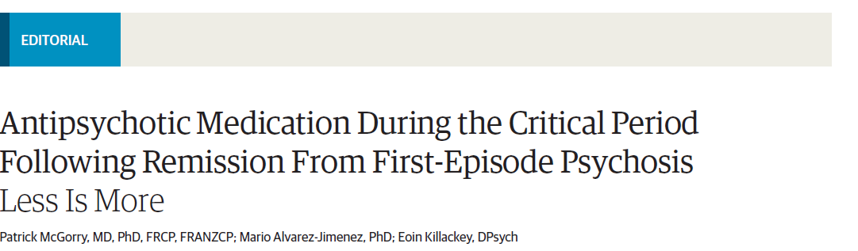

Slide 43
Poor outcome psychosis
Artifact of:
Late detection
Crude and reactive use of pharmacotherapy
Sparse psychosocial care
Social neglect

Slide 44
Contained relapse
Rarely the end of the world
Price worth paying for better functional recovery

Slide 46
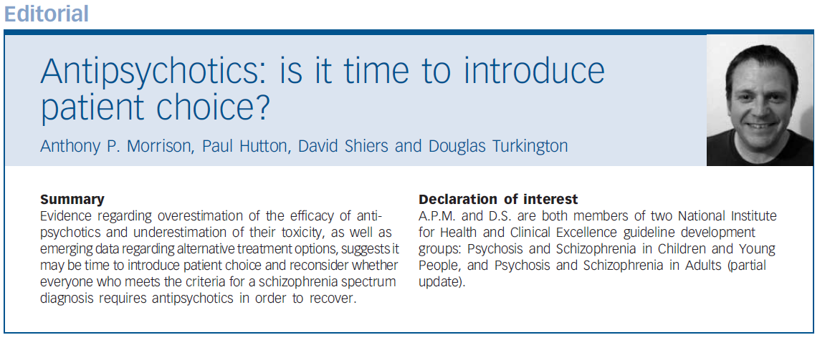

Slide 47
Study Morrison, PM 2012
20 patients, schziophrenia, no medication
Open study
Betere PANSS score
Beter sociaal functioneren

Slide 51
Results
Beter PANSS scores
Similar adverse events
Safe and acceptable alternative for those who have chosen not to use antyipsychotic drugs

Slide 52
every chronic schizophrenic outpatient maintained on antipsychotic medication should have the benefit of an adequate trial without drugs
Gardos 1976

Slide 53
The future
more research to establish the pros and cons of long-term antipsychotic treatment
evaluate a gradual and individualised approach to antipsychotic discontinuation
outcomes other than relapse
Longer-term follow-up of five to ten years

Slide 55
Discontinuation symptoms

Slide 57
Withdrawal after discontinuation
Agitation interpreted as psychosis
Withdrawal as trigger for underlying condition
Discontinuation may be psychotogenic (cases metoclopramide)

Slide 58
Conclusion
Community psychiatry requires antipsychotics
Learn to make the distiction between those who do or do not need MT
Soteria paradigm at least as effective as traditional hospital based treatment
Medication no longer / not yet the discriminating factor
Practice Soteria in the community

Slide 59
To continue or NoT to continue
A single-blind randomized superiority trial comparing continuation of antipsychotic medication to discontinuation/dose reduction after a first psychosis

Slide 60
What we know
Antipsychotic medication is effective to treat psychosis
Antipsychotic medication after remission of psychosis reduces relapse and re-hospitalisation
Antipsychotic medication has negative effects on motivation, learning ability and mood
Many patients discontinue medication despite doctors advise to continue

Slide 61
What we need to know
Is social recovery better if antipsychotic medication is gradually tapered of at an early stage as compared to continuation (TAU)?
Which personal and treatment factors predict successful discontinuation of medication?
What is the cost-utility of discontinuation compared to continuation?
Can we implement the optimal strategy during the trial?

Slide 62
Pragmatic single-blind Superiority Trial
512 patients 3-6 months in remission after first psychosis
randomized 1:1 to:
- continuation antipsychotic medication ≥ 1 year (TAU) or
- gradual discontinuation antipsychotic medication
Intention to treat with minimal exclusion criteria

Slide 63
Outcome measures
Assessed by a trained rater blind to condition
Primary:
WHODAS ability scale (selected by patients)
Secondary
Subjective wellbeing and QoL
EMA: mood, anxiety, sleep and paranoia
Severity of symptoms, relapse rate, hospitalisation and service use
Aggression incidents and suicidal acts
Side effects, metabolic syndrome and physical health

Slide 64
WHODAS
6 Domains of Functioning, including:
Cognition – understanding & communicating
Mobility– moving & getting around
Self-care– hygiene, dressing, eating & staying alone
Getting along– interacting with other people
Life activities– domestic responsibilities, leisure, work & school
Participation– joining in community activities

Slide 65

Psychosis Consortium
www.psychoseconsortium.nl

Slide 66
Centers and PIs
GGZ NHN S Veerman
GGZ Rivierduinen JP Selten (2 teams)
Arkin M Kikkert (2 teams)
GGZ Ingeest A Steenhoven (2 teams)
Altrecht T Starink
GGZ Centraal R. Bakker (2 teams)
Reinier van Arkel K Grootes
GGZ E M Marcelis (2 teams)
Mondriaan T v Amelsvoort
Lentis R Knegtering (2 teams)
GGZ Friesland
L Wunderink
UMCG W Veling
AMC L de Haan
UMCU I Sommer
GGZ Delfland N Veen
GGZ Delta N v Beveren
Yulius A v Gool
UzA J Luykx
Parnassia M vd Gaag (4 teams)
MUMC J v Os

Slide 67
Antipsychotics: slow up, slow down
From crude and reactive use to
Timely, rational, low dose
Start low, go slow
Reduce as soon as possible
Reduce …go as slow as you can: taper

Slide 68


